Slide 1
Tableau Assignment_2
File created on: 1/27/2024 5:45:40 AM

Slide 2
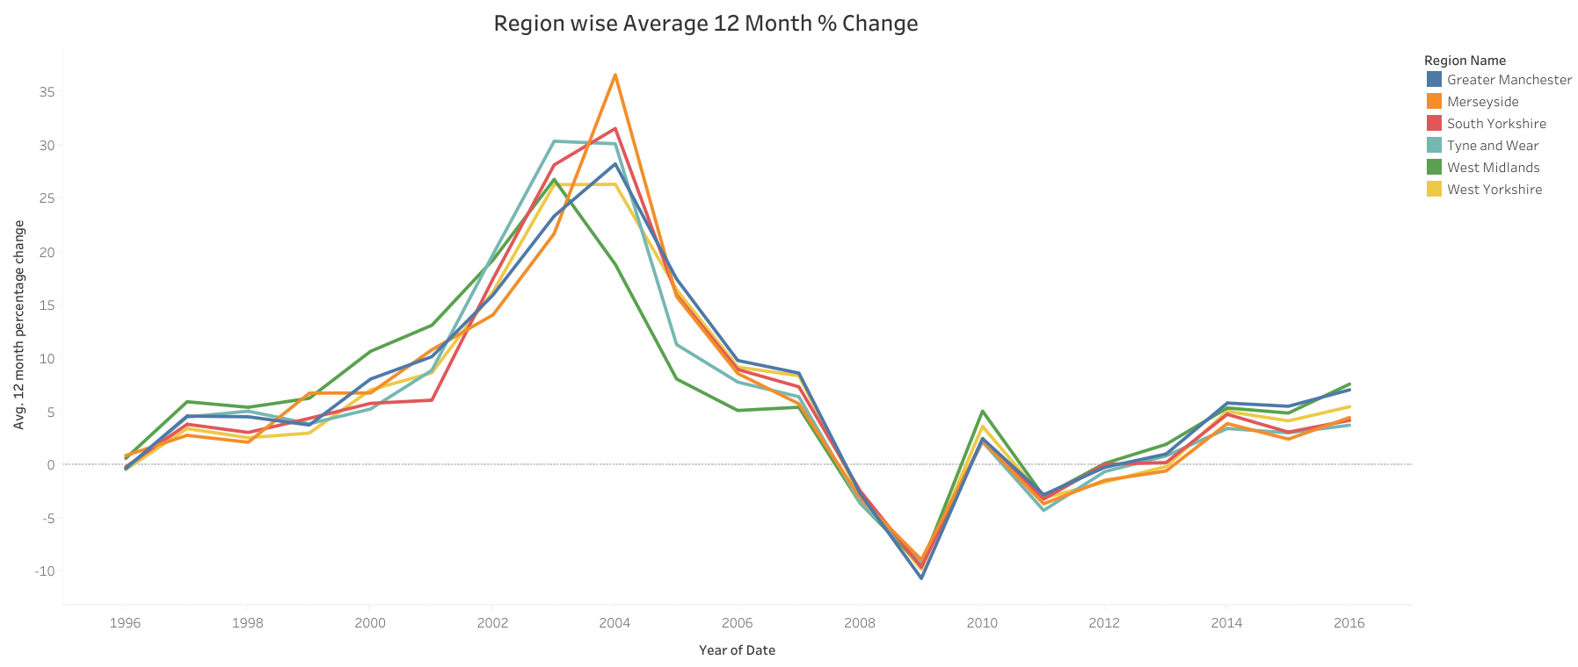

Slide 3
